Slide 1
Tariff design
Jan 30

Slide 2
 | Native demand | Electrified demand | Solar + storage | Other electrified appliances
Tiered
Tiered + TOU
TOU (EV rates)
Income graduated fixed charges
As of oct 1, SDGE is the first utility in the state to implement IGFC!
Affordability implications of changing rate designs and electric appliance adoptions across the state

Slide 3
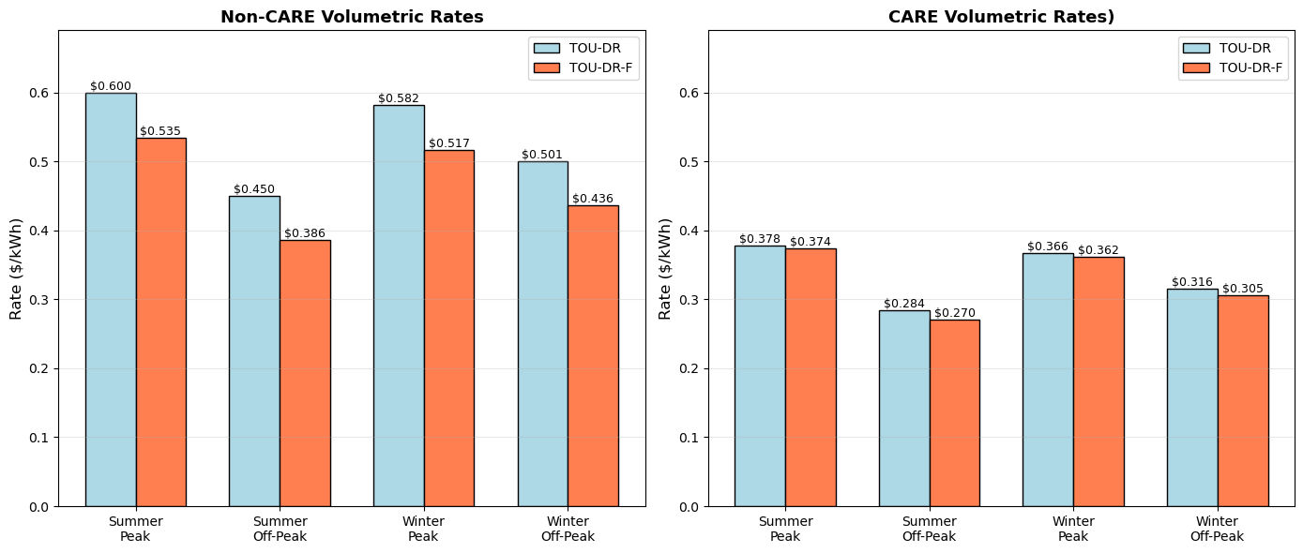
Oct 1, SDGE moved from volumetric -> volumetric + fixed rate
Fixed rate for CARE customers: $6 (orange)
Everyone else (medium or high income): $24 (orange)

Slide 4
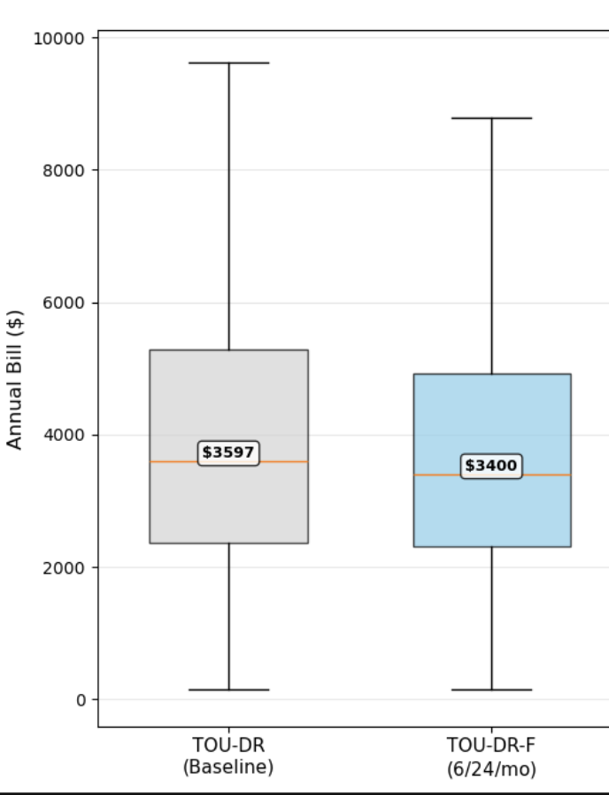
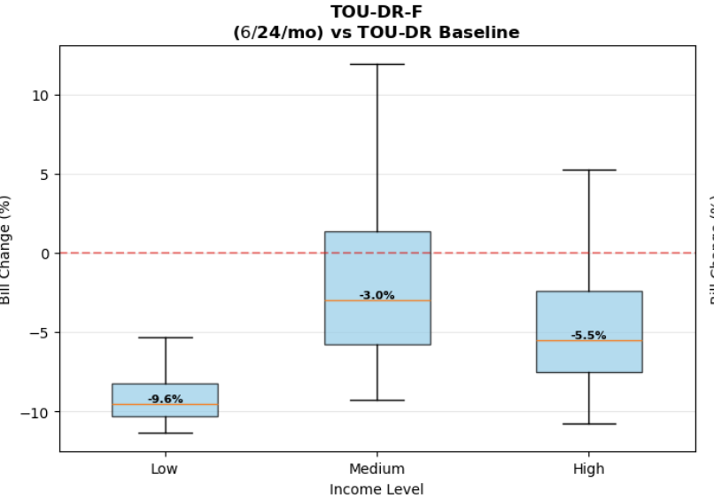
Oct 1, SDGE moved from volumetric -> volumetric + fixed rate

Slide 5
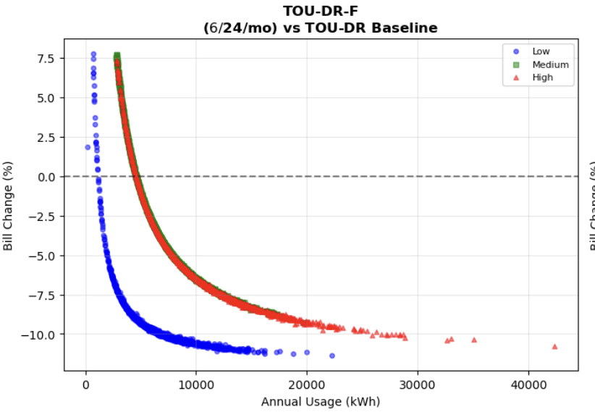
Bill increased for low electricity consumption, decreased for others

Slide 6
This was partly SDGE’s effort to also reduce rates, but how do future rates evolve
E3 tool
Not nimble
Not transparent
No policies
Building our rate designer with levers we can change for affordability
Increased fixed costs of revenue requirement recouped through fixed charges
Remove wildfire costs (policy)
Reduce rate of return
Disadvantage is that we’re missing a lot of ground-truth data that E3 had (customer consumption with income)

Slide 7
Rate designer
Starts with: Current SDGE TOU-DR (not the new fixed cost) rate structure as baseline (~$1.56B residential revenue)
Designs new rates by:
Fixed charges: Moves 0-100% of Transmission & Distribution costs from volumetric to fixed monthly charges [some differences in revenue requirement]
Income graduation: CARE customers pay 40% of non-CARE fixed charges ($6 vs $24/month currently) [thinking]
Wildfire: Option to remove $153M wildfire costs from rates
ROR reduction: Option to reduce rate of return by 0.5-1.5 percentage points
Maintains: Revenue neutrality when only changing fixed charge percentage (F0% and F50% collect same total revenue)
Adjusts: Total revenue down when removing wildfire costs or reducing ROE
Scales: All volumetric rates proportionally using current (Sept 31 2025) TOU peak/off-peak ratios

Slide 8
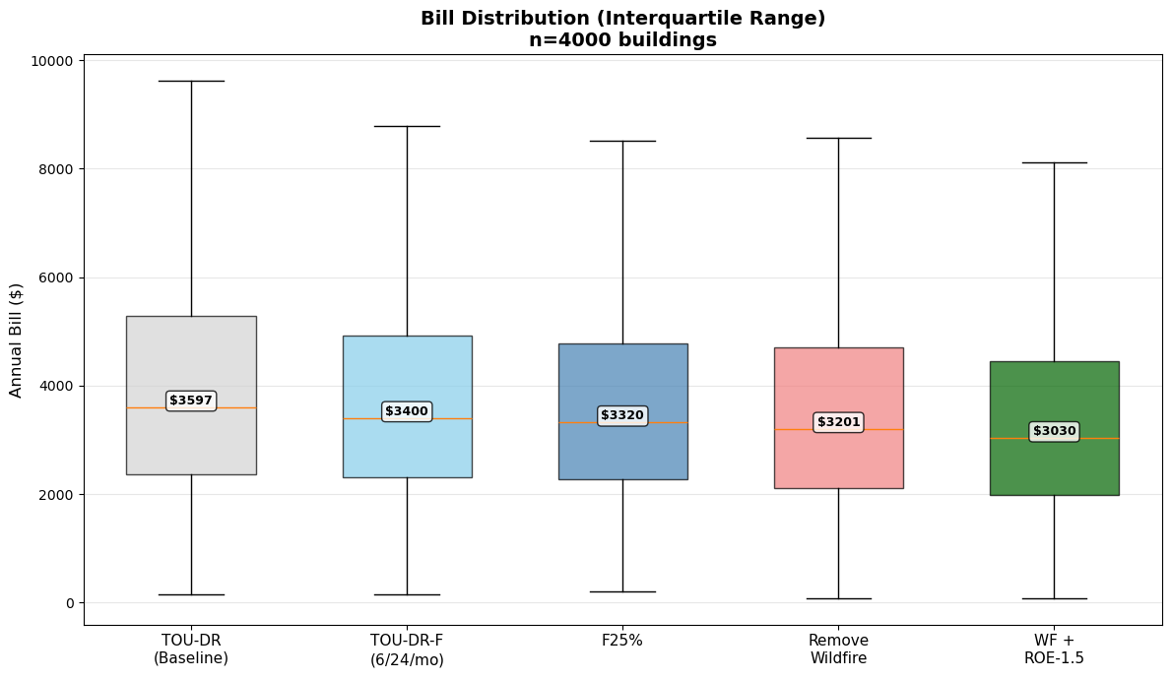
Results on native demand
25% of fixed costs, no policies
Removing wildfires from RR
Removing wildfire and reducing ROR by 1%

Slide 9
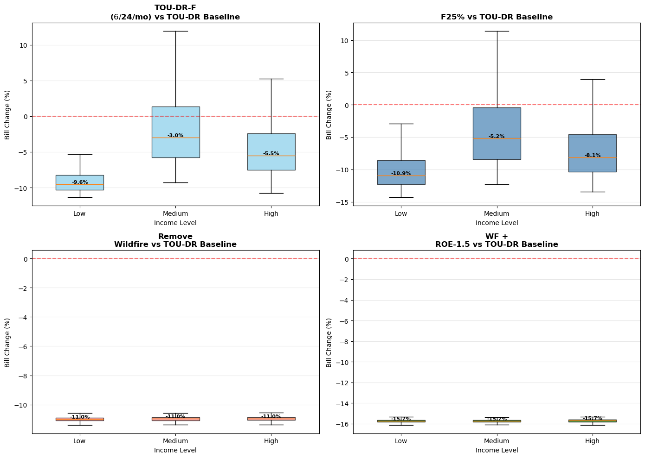
Results on native demand
25% of fixed costs, no policies
Removing wildfires from RR
Removing wildfire and reducing ROR by 1%

Slide 10
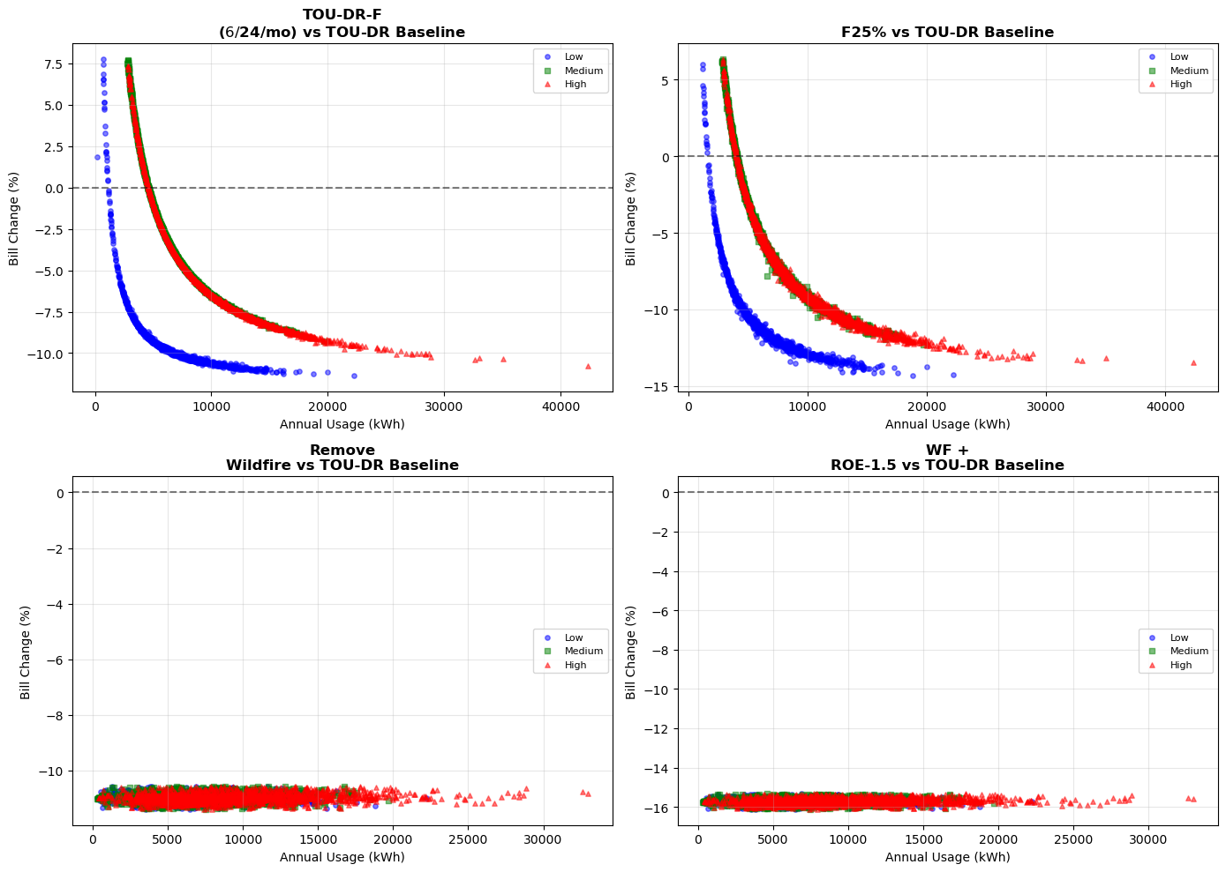
Results on native demand

Slide 11
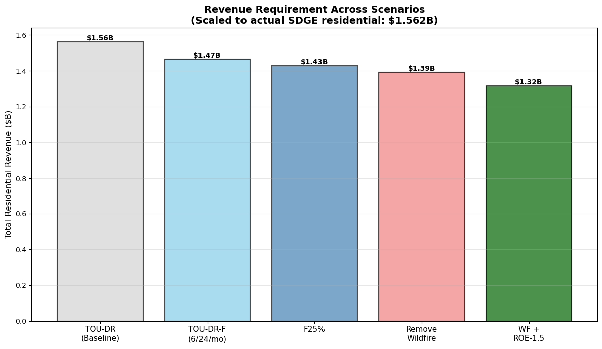
Revenue requirement (Residential) - still figuring out the missing 0.1 and 0.01 billions

Slide 12
 | Native demand | Electrified demand | Solar + storage | Other electrified appliances
Tiered
Tiered + TOU
TOU (EV rates)
Income graduated fixed charges
As of oct 1, SDGE is the first utility in the state to implement IGFC!
Affordability implications of changing rate designs and electric appliance adoptions across the state

Slide 13
Thrust 4: Tariff Design
CCA all-hands meeting, Oct 3 2025 Team: Madalsa, Rajni, Ranjit, Patricia
Special thanks to Sebastian Cox for initial help in compiling rate data

Slide 14
 | Native demand | Electrified demand | Solar + storage | Other electrified appliances
Tiered
Tiered + TOU
TOU (EV rates)
Income graduated fixed charges

Slide 15
 | Native demand | Electrified demand | Solar + storage | Other electrified appliances
Tiered
Tiered + TOU
TOU (EV rates)
Income graduated fixed charges
Bill impacts across geography, (local) income, and housing is understudied, especially under a rapidly changing rate design paradigm in the state

Slide 16
 | Native demand | Electrified demand | Solar + storage | Other electrified appliances
Tiered
Tiered + TOU
TOU (EV rates)
Income graduated fixed charges
As of oct 1, SDGE is the first utility in the state to implement IGFC!
Bill impacts across geography, (local) income, and housing is understudied, especially under a rapidly changing rate design paradigm in the state

Slide 17
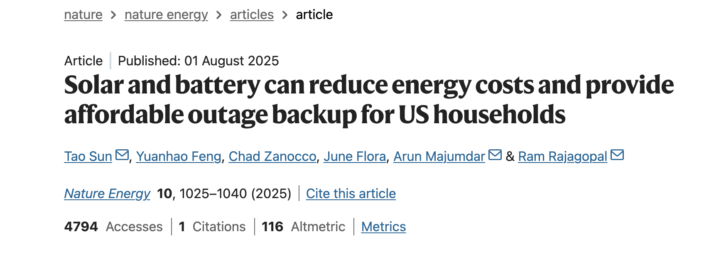
 | Native demand | Electrified demand | Solar + storage | Other electrified appliances
Tiered
Tiered + TOU
TOU (EV rates)
Income graduated fixed charges
As of oct 1, SDGE is the first utility in the state to implement IGFC!
Bill impacts across geography, (local) income, and housing is understudied, especially under a rapidly changing rate design paradigm in the state

Slide 18
Research questions
Tiered → Tiered + TOU or TOU only
Should we preserve any geographic baseline in rate design? Tiered rates have different baseline allowance by region
Original rates → rates with fixed charges
Bill impacts by region and income
How do efficiency upgrades by income and regions affect bills?
How does moving to demand response and DER adoption change customer bills? What are the equity implications of fixed charges? Especially if we pursue a higher fixed charge?
How does income identification impact bills?
Ex: assigning income randomly vs rank-based
ResStock has it’s own income classification
We classify based on an algorithm than combines RASS, census data (median income etc)

Slide 19
Methods
Efficiency upgrades
Technology
(Solar and storage)
Native
demand
Rates
Annual bills
(Dispatch)

Slide 20
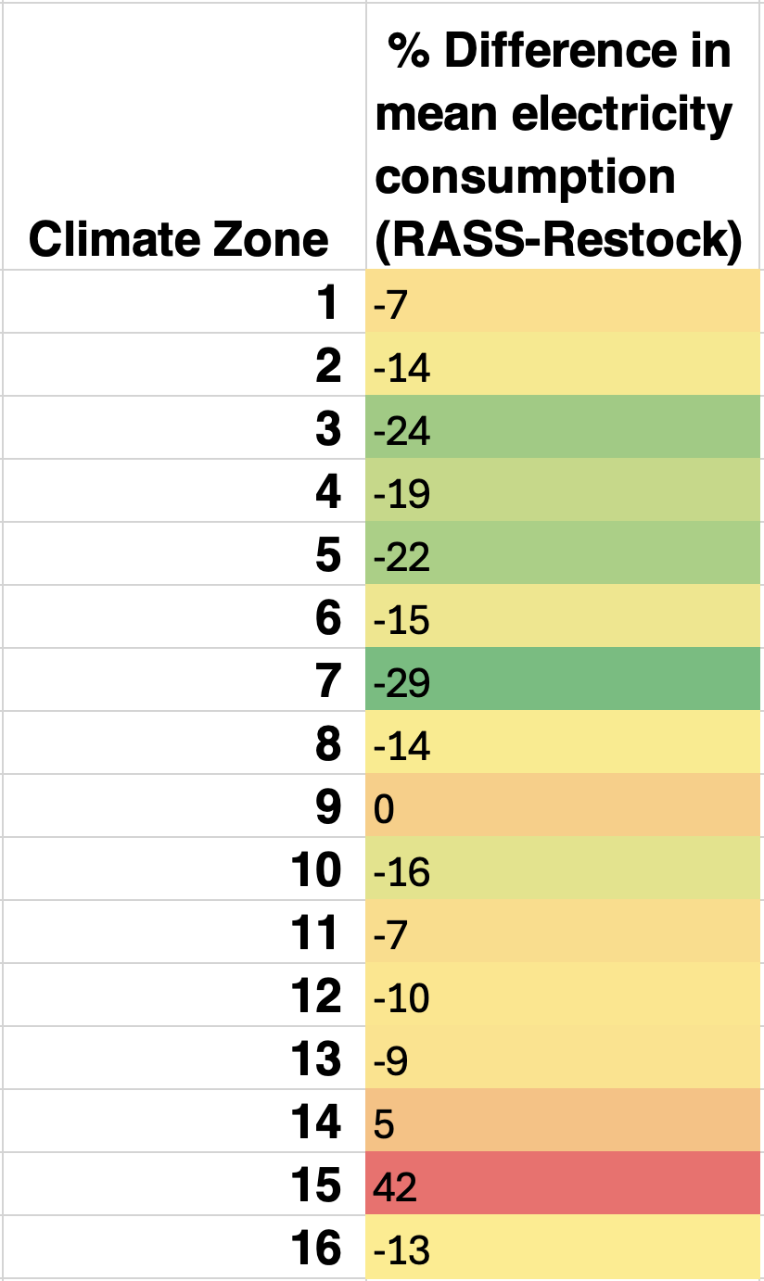
Methods
ResStock is building simulation, need to root it in actual CA electricity data
Problem: ResStock overestimates
energy consumption in colder CZ and
underestimates in hotter zones
Problem: We technically don’t know the
income of building. ResStock has it’s own
Way to prescribe income, but it is not CA
specific
Efficiency upgrades
Technology
(Solar and storage)
Native
demand
Rates
Annual bills
(Dispatch)

Slide 21
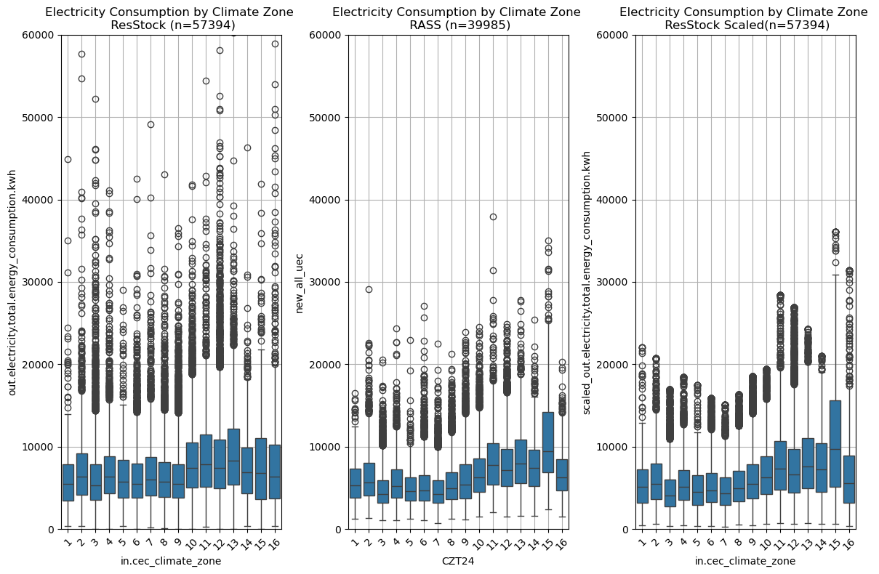
Methods
Solution: benchmark ResStock to RASS using scaling factors and winsorizing the distribution
Efficiency upgrades
Technology
(Solar and storage)
Native
demand
Rates
Annual bills
(Dispatch)

Slide 22
Methods
Efficiency upgrades
Technology
(Solar and storage)
Native
demand
We use upgrade 11 with previously derived scaling factors to find new electricity demand with efficiency
Rates
Annual bills
(Dispatch)

Slide 23
Methods
Our solar and storage sizing is heuristic based
Solar - sized to produce annual load and each house is given a powerwall
Simple dispatch - linear program with again simplifications to improve computational speed
3 export compensations - 100%, 30%, 0% (ACC is roughly between 0-30% depending on time of the year)
TODO: ACC 2025
Not adding extra electrification – Ana’s paper
Efficiency upgrades
Technology
(Solar and storage)
Native
demand
Rates
Annual bills
(Dispatch)

Slide 24
Methods
Developed a very detailed rate module (took most time, and continues to). Tracks
Minimum bill
Baseline charges
Baseline allowance (for each utility and climate zone)
Efficiency upgrades
Technology
(Solar and storage)
Native
demand
Rates
Season, hour, weekend/weekday for TOU
Tiered, TOU+tiered, TOU only, new rates with fixed charge (SDGE just started on Oct 1)
Hypothetical future rates with fixed charges (50% of all fixed cost recouped through fixed charges)
CARE/FERA discount
Annual bills
(Dispatch)

Slide 25
Methods
Tracking annual bills, dispatch, exports for
Utility
Climate zone
Income
Building type
Rate type
TO DO:
Add avoided cost by grid
Marginal avoided GHG emissions with marginal emissions factors (damages $)
Efficiency upgrades
Technology
(Solar and storage)
Native
demand
Rates
Annual bills
(Dispatch)

Slide 26
Results (SDGE, including Oct 1 2025 rates) [presented PGE in July]

Slide 27
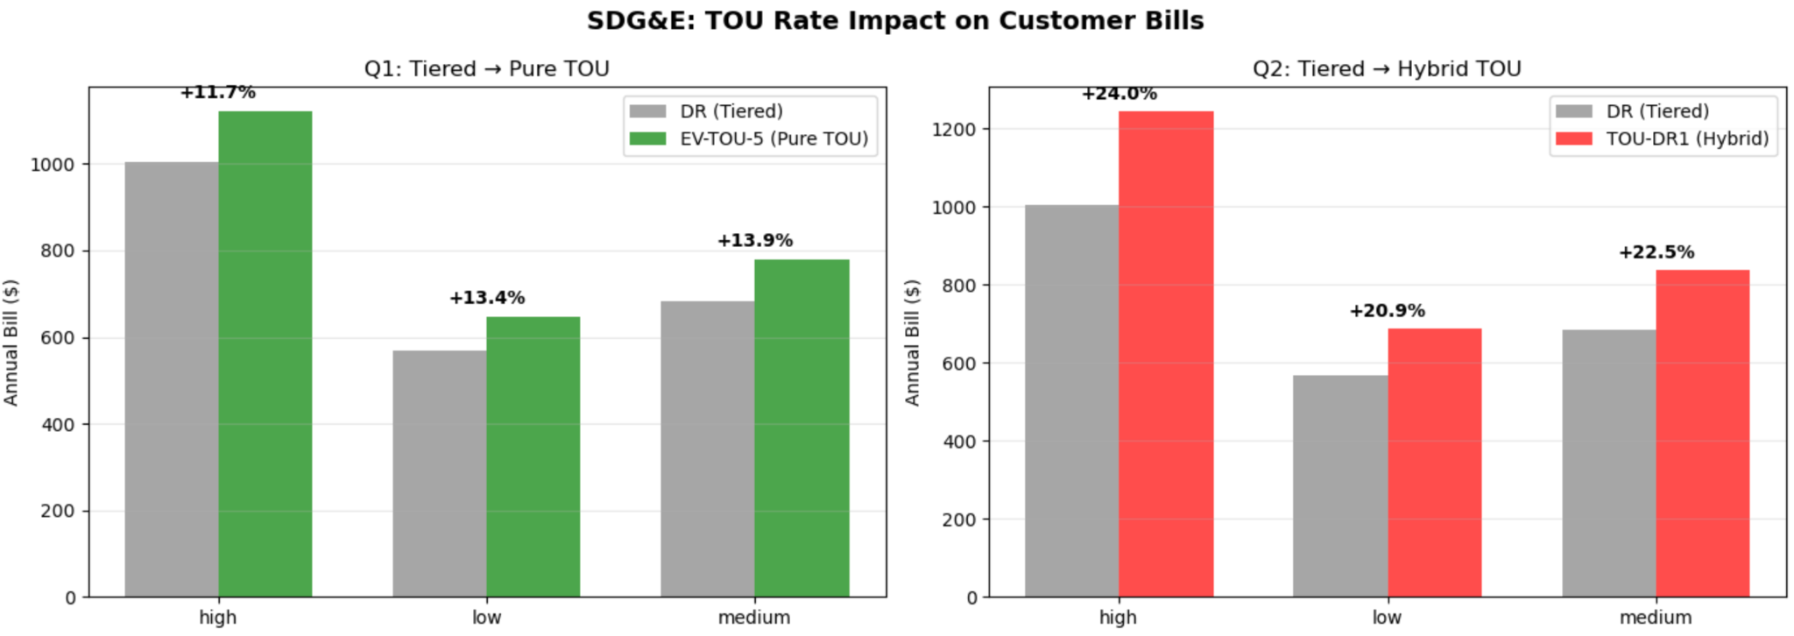
Tiered -> TOU rates (baseline)

Slide 28
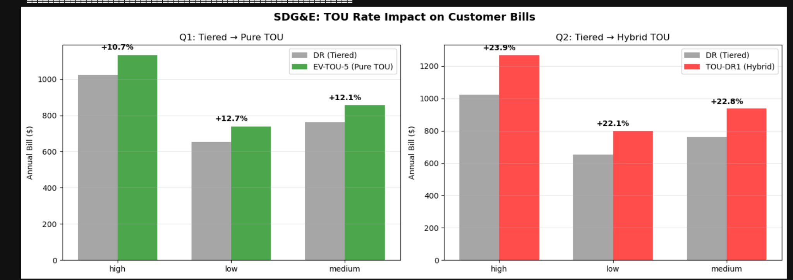
Tiered → TOU rates (baseline, upgrade 11)

Slide 29
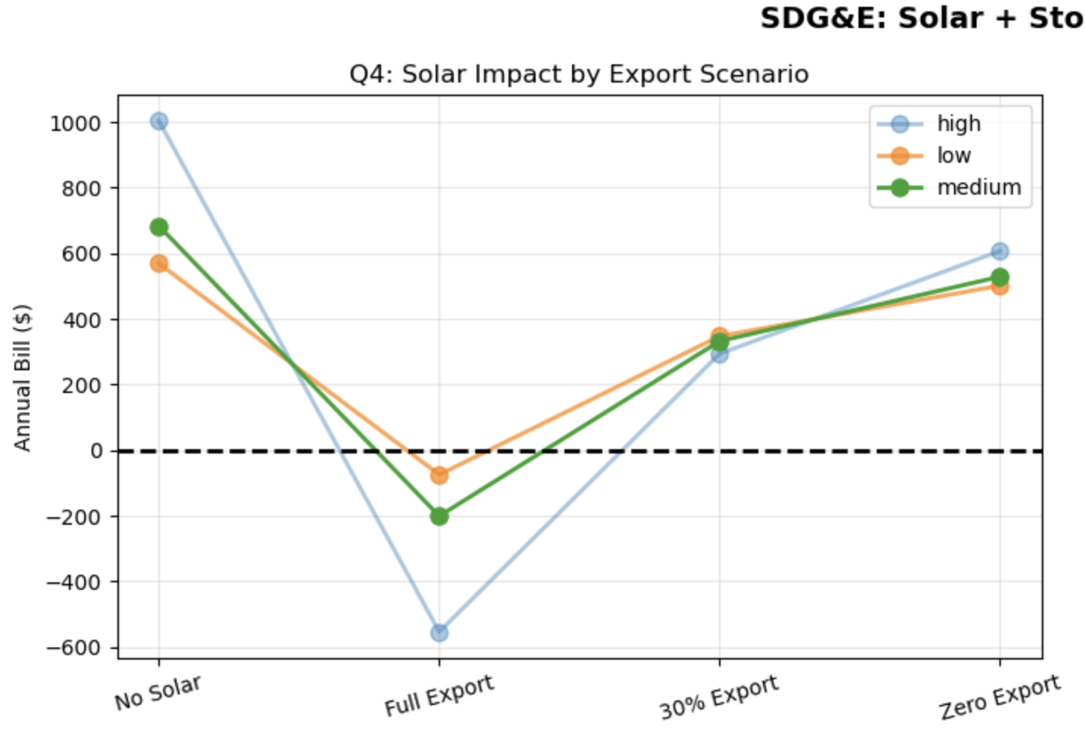
Solar + storage bills by income (baseline, TOU DR1)

Slide 30
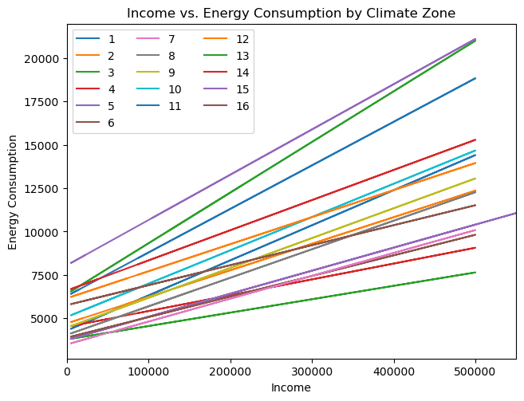
Solar + storage bills by income (baseline, TOU DR1)

Slide 31
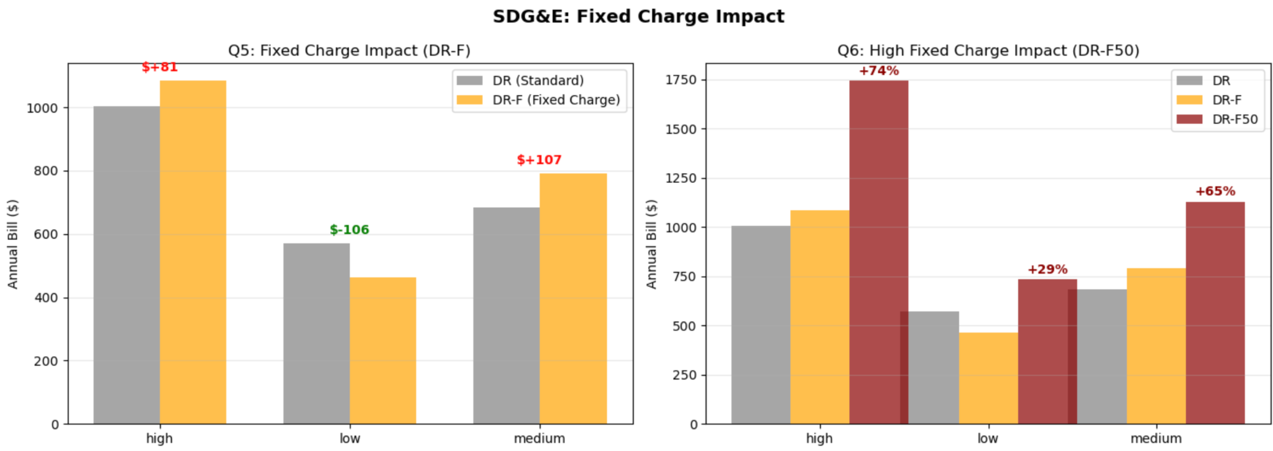
Fixed charge impacts (baseline, tiered rate)

Slide 32
Fixed charge impacts (baseline vs upgrade, tiered rate)

Slide 33
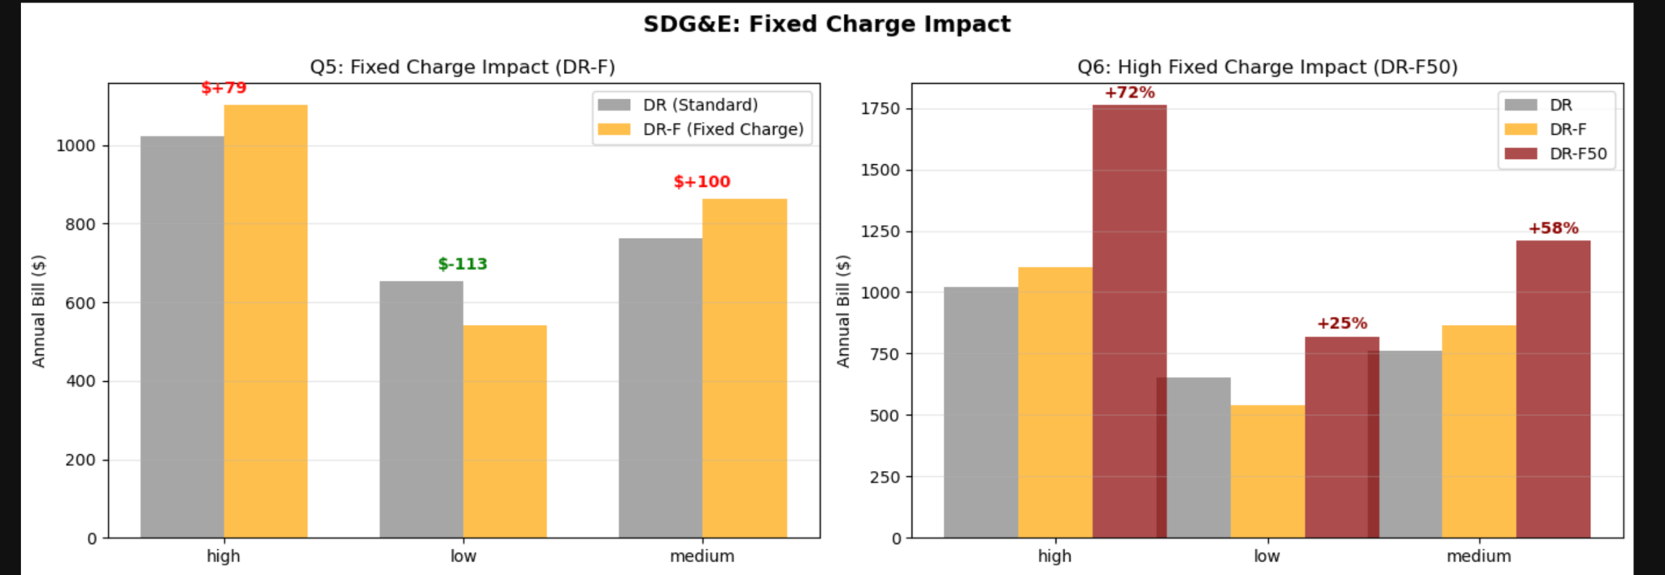
Fixed charge impacts (baseline, tiered rate)

